Slide 1
Remediation Business Intelligence
Roger Well
Vice President

Slide 2
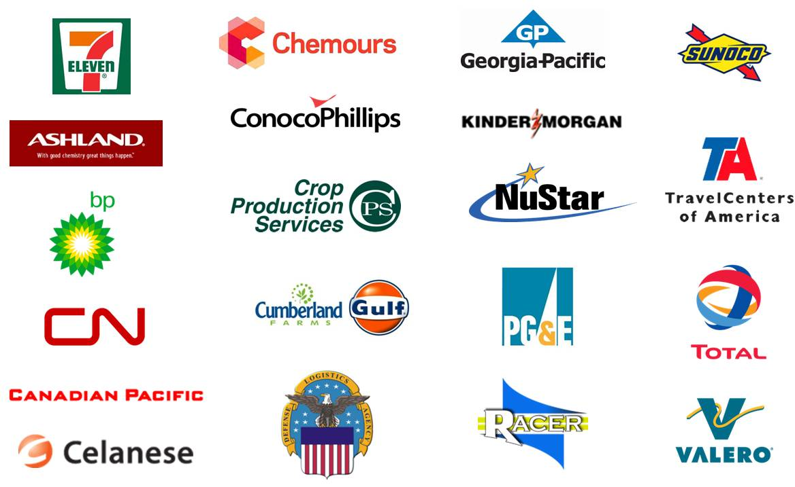
World Class Clients

Slide 3
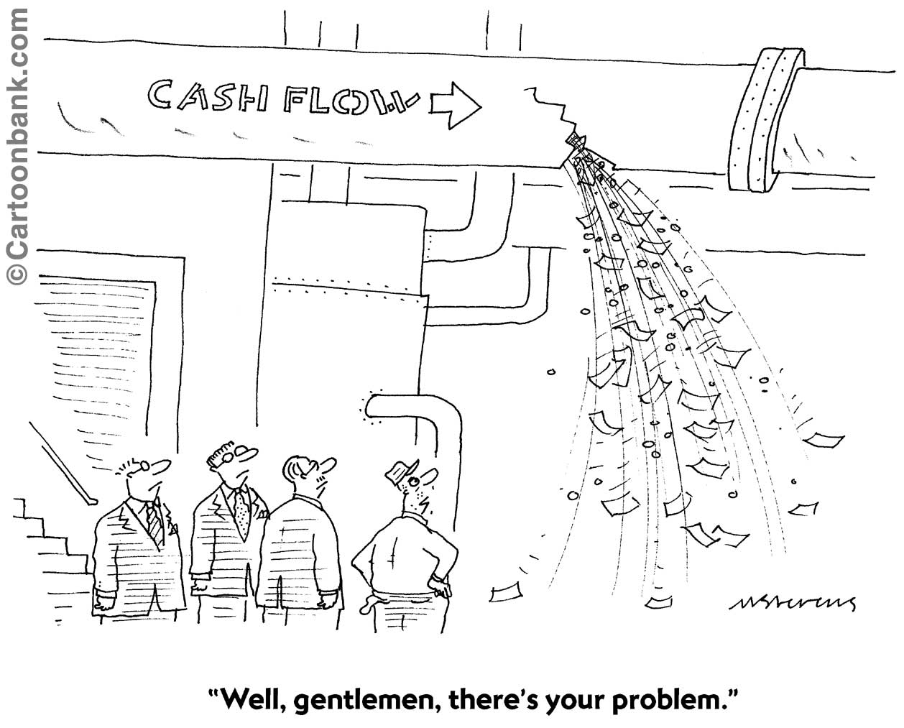

Slide 4
Outline
Why Business Intelligence for Remediation?
Remediation Business Intelligence Examples
A Business Intelligence Roadmap

Slide 5
Outline
Why Business Intelligence for Remediation?
Remediation Business Intelligence Examples
A Business Intelligence Roadmap

Slide 6
Industry Progression
Innovative Contracting, Procurement, Risk Transfer, Insurance, Institutional Controls
Risk-Based Corrective Action, Natural Attenuation, Phyto, 2nd Wave of Bio
Free Phase Removal, Dig & Haul
Pump & Treat, SVE, Sparging, 1st Wave of Bioremediation
Information Technology, Automated Business Process Mgmt, Data Driven Decision Making
1980s and 1990s
1990s and 2000s
Today
Driven by Consultants
(Remediation Era)
Driven by Industry
(Risk Era)
Driven by Owner
(Information Era)

Slide 7
Question:
What is the percent of environmental costs attributed to information management activities?
BTI Consulting Group

Slide 8
64%

Slide 9
A survey of 1,400 CIOs showed that BI is the #1 technology priority.
Gartner Survey

Slide 10
Business Intelligence & Analytics
Optimization | What’s the best that can happen?
Predictive modeling | What will happen next?
Forecasting/extrapolation | What if these trends continue?
Statistical analysis | Why is this happening?
Alerts | What are actions are needed?
Query/drill down | Where exactly is the problem?
Ad hoc reports | How many, how often, where?
Standard reports | What happened?
Analytics
Competitive Advantage
Access & Reporting
Degree of Intelligence
Source : SAS

Slide 11
Companies that compete on analytics have a razor sharp focus on performance drivers as they relate to value creation.

Slide 12
Value Driver Tree
Provides Strategic Clarity
TIER II (Business Function)
TIER I (Generic)
1. Reputation and Brand Risk Protection
1. Revenue Growth
2. Environmental Revenue Streams
3. Asset Revenue Optimization
4. Accrual Reductions (Reserve Replenishments)
ENFOS Core Value Drivers
SHAREHOLDER VALUE (Market Capitalization)
2. Increased Profit Margins
/ Net Income
5. Environmental Expense (OPEX) Reductions
1. Accrual Reductions
(Reserve Replenishments)
6. Internal Operating Cost Reductions
7. Increase Process/Operating Efficiency & Productivity
2. Internal Operating Cost Reductions
8. Stable and Predictable Cash Flow
3. Increased Efficiency & Productivity
3. Free Cash Flows
(Operating Cash – Capital Expenditures)
9. Improved Environmental Cost Recovery
4. External Operating Cost Reductions
10. External Operating Cost Reductions (Suppliers/Vendors)
4. Working Capital Improvement
(Current Assets – Current Liabilities)
5. Lowering of Cost Structure for Liability Retirement
11. Reduction in Settlement Costs for Short Term Liabilities
5. Discount Rate
(Weighted Average Cost of Capital)
12. Improved Environmental Risk Prevention & Programs
6. Improved Risk Reduction
& Mitigation
6. Competitive Advantage Period
(Above COC Return Growth Period)
13. Improved Environmental Criteria for Project Selection
14. Lowering of Cost Structure for Liability Retirement
TIER III
15. Improved Valuation of Impaired Assets
ENFOS
Unique Value Drivers
7. Long Term Liability Reduction
16. Reduced Legal Risks
17. Improved Liability Forecasting Accuracy
18. Improved Risk Reduction & Mitigation

Slide 13
Outline
Why Business Intelligence for Remediation?
Remediation Business Intelligence Examples
A Business Intelligence Roadmap

Slide 14
Domains for Remediation Analytics
INTERNAL | EXTERNAL
Financial | Spend
Technical Risk Locations Compliance Legal People | Suppliers Regulators Regulations Communities Demographics
Financial Attributes
Non-Financial Attributes

Slide 15
Key Financial Measures
Estimate to Complete (ETC) Growth Rate
Accrual Growth Rate
ETC Turnover Ratio
Cash Efficiency
Cash Margin
ETC Turnover Rate
ETC Multiplier
Measure by:
Program as a Whole
Business Unit
Facility Type
Individual Project
Consultant
Manager

Slide 16
Key Technical Measures (non-financial)
New Site Growth Rate
Closure Rate
Site Turnover Ratio
Remediation Progression Rate
System Shut Down Rate
Sample Point Growth Rate
Measure by:
Program as a Whole
Business Unit
Facility Type
Individual Project
Consultant
Manager

Slide 17
Data Population Group
Facility Type | Sites
Service Stations | 4,483
Truckstops | 126
Pipeline (Petroleum) | 32
Terminals | 905
Pipeline (Gas) | 51
Chemical Plants | 122
Manufactured Gas Plants | 50
Superfund | 17
Refineries | 45

Slide 18
Facility Type Annual Spend Analysis
Facility Type | Sites | Spend / Site
Service Stations | 4,483 | $28,291
Truckstops | 126 | $38,860
Pipeline (Petroleum) | 32 | $66,729
Terminals | 905 | $75,546
Pipeline (Gas) | 51 | $111,422
Chemical Plants | 122 | $175,442
Manufactured Gas Plants | 50 | $403,055
Superfund | 17 | $711,125
Refineries | 45 | $1,192,604
3-Year Average (2008-10)

Slide 19
Change Order Analysis
50
47
50
Total Spend $1.1B
CO Spend $ 98M
Average = 9%
%
CO Spend to Total Spend
40
40
30
30
%
20
17
20
12
10
7
10
5
3
A
B
C
D
E
F
Company

Slide 20
Remediation Spend Composition Analysis
Information Technology improves Labor Efficiency which lowers Cost
Average Annual Spending Distribution by Cost Component
Labor
65%
Subcontractors
13%
Equipment
5%
Lab
5%
Waste Removal/Disposal
4%
Drilling
4%
Utilities
3%
Materials
2%
0
10
20
30
40
50
60
70
%

Slide 21
Reserve Balance (ETC) Analysis
Facility Type | Estimate to Complete | Sites | ETC per Site
Service Stations | $472,852,205 | 5,966 | $79,258
Terminals | $180,705,061 | 403 | $448,400
Chemical Plants | $136,432,433 | 138 | $988,641
Refineries | $466,766,351 | 52 | $8,976,276

Slide 22
Cash Efficiency Metric
Example: 1 Site
Cash Efficiency = (ETC_{b} – ETC_{e}) / Spend
“How efficient is your spending at reducing the reserve?”
ETC_{b} = $100,000
ETC_{e} = $80,000
Spend = $30,000
($100 - $80) / $30 = 0.66

Slide 23
Financials
ETC Balance
Example: 1 Site
$Thousands
$100
$100
$20,000 Net Decrease
$90
$80
$80
$70
$60
Cash Efficiency = 0.66
Beginning of Year
End of Year
+50
Accruals
$10
0
Expenditures
$30
-50
ETC Adjustments
(Accrual made that year)
Actual Spending
(During the year)

Slide 24
The Rest of the Story
Explaining the Replenishments
(Plan Change Reasons)
Project Duration Extensions
10%
Change in Facility
(Operations)
30%
Change in Strategy
15%
Regulatory Changes
20%
Under-Estimated Costs
25%

Slide 25
CTC Multiplier (Predictive)
Example: 1 Site
Only for Sites with a Cash Efficiency > 0
“Based on past performance, predict the sites that I am under-reserved on and by how much.”
ETC Multiplier = 1/CE
In our Example: 1/0.66 = 1.52
$80,000 x 1.52 = $121,600

Slide 26
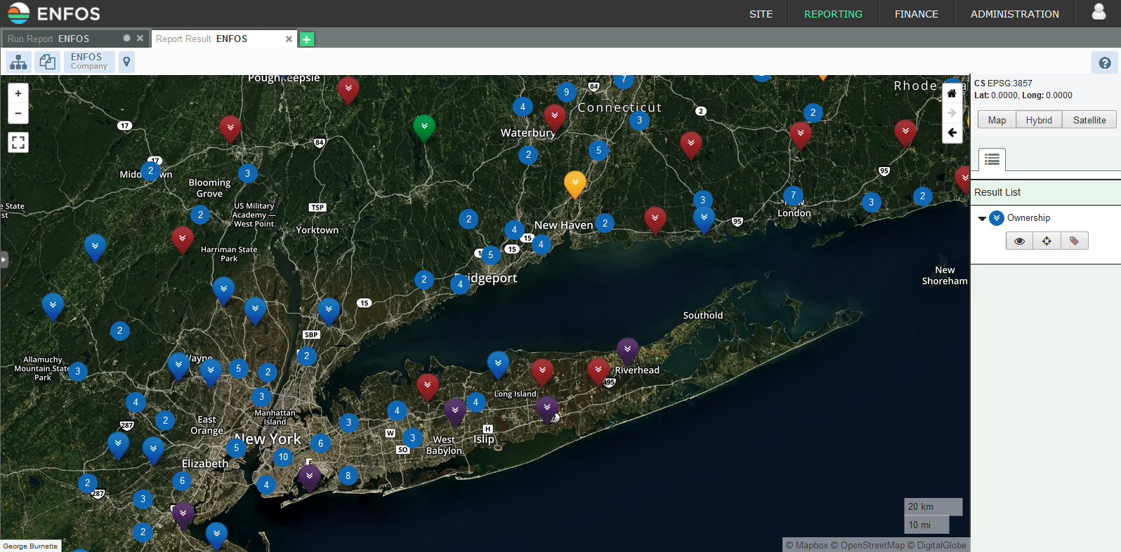
Visualization Techniques Enhance Analysis

Slide 27
Outline
Why Business Intelligence for Remediation?
Remediation Business Intelligence Examples
A Business Intelligence Roadmap

Slide 28
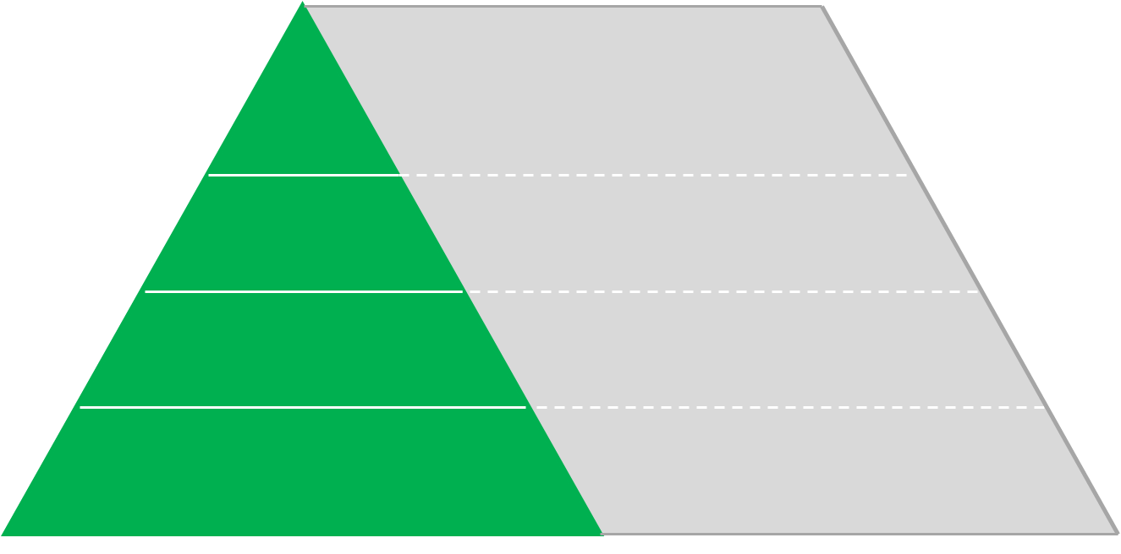
Roadmap Stages
Information Value
Predictive Models
Algorithms
“What if” Scenarios
Statistics
LEVEL 4
Strategic Management
LEVEL 3
KPIs
Dashboard
Scorecards
Business Performance Management
LEVEL 2
Financial Processes
Remediation Processes
Regulatory Processes
Risk Management Processes
Compliance Processes
Business Process Management
LEVEL 1
Master Data
Facility & Asset Data
Accrual Data
PO & Invoice Data
Lab & Field Data
Compliance Data
Receptor & Toxic Site Data
Transactional
Data & Reporting

Slide 29
Informational Value
STAGE | INFORMATIONAL FOCUS | QUESTIONS ASKED?
1. Transactional | High quality data with single-version of the truth | What happened? How much, how often, where? Is the data reliable?
2. Process | Execute the business with maximum efficiency and effectiveness | What can we do to improve this activity? Does this activity add value? Why are we doing this?
3. Performance | Use fact-based, business intelligence to drive organizational performance | How well are we doing? What are the indicators of future performance?
4. Strategic | Contextual and integrated data used to evaluate and predict events that may have a material impact on the business | Why is this happening? What if the trends continue? What will happen next? When is action needed?

Slide 30
Contact Information
Headquarters 2929 Campus Drive
Suite 415
San Mateo, CA 94403
Phone: 650-357-0007
Midwest
1952 McDowell Road
Suite 103
Naperville, IL 60563
Phone: 630-689-0220
International
Spain
Switzerland
UAE
roger@enfos.com
www.enfos.com

